Slide 1

Image recoloring based on fast and flexible palette extraction
Authors of the presentation: Astafev Vadim and Dmitriev Stepan

Slide 2

Objectives
To introduce what image recoloring is
To tell about the main methods of image recoloring
Provide an image recoloring algorithm based on fast and flexible palette extraction
Analyze the disadvantages of recoloring images

Slide 3

Introduction
Method for changing the color of an image that allows you to quickly and flexibly select a color palette for editing.

Slide 4
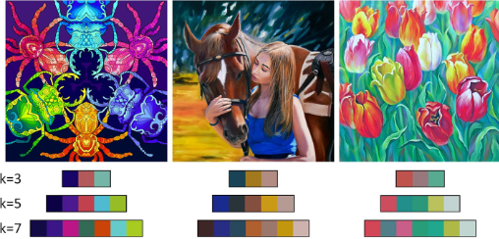
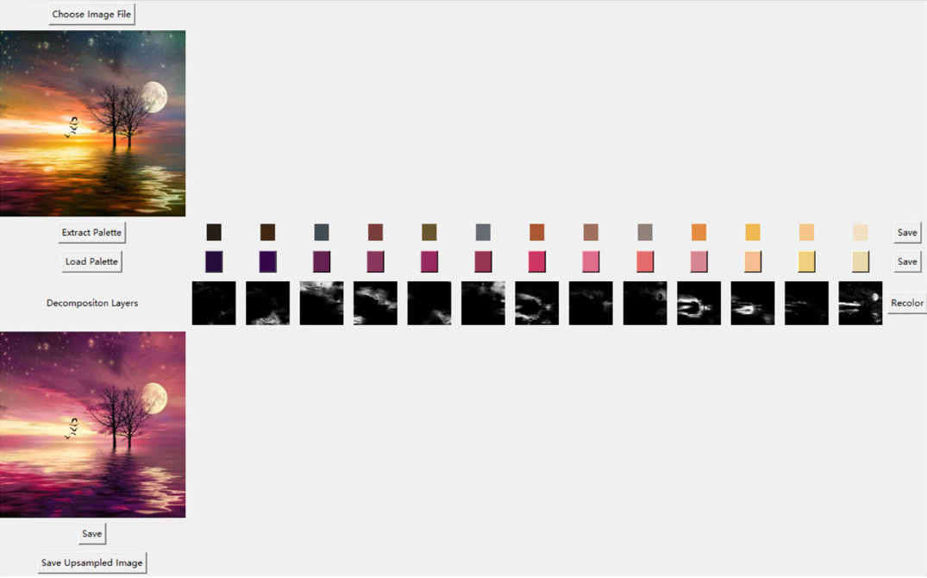
Image recoloring methods
A new simple method for recoloring images based on palettes is presented.
A. Linguistic Steganography
Palette extraction network (P-Net)
2) Color Decomposition Network (D-Net)

Slide 5



Methodology
A color palette is a set of colors used in design, painting, graphics, and other fields. It can include basic colors, shades and combinations to create a harmonious image. The color palette helps to convey the mood, emotions and style of visual works.
Zero-width characters come in a variety of forms that can be steganographically used. Typical color patterns include:
LAB is a color model with lightness components, red—green and yellow-blue components.
RGB is a color model based on red, green and blue used in electronics and graphics.

Slide 6
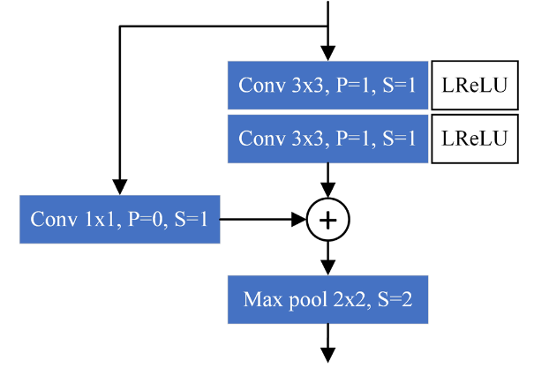
The P-Net method extracts a palette from images using 6 blocks of residual convolution, adaptive maximum pooling and a fully connected layer. It calculates (k+1) colors, including black, then removes black and stores only k colors. The palette is trained based on the loss of the Euclidean distance between the colors of the palette and the colors of the image in the LAB space.

Slide 7
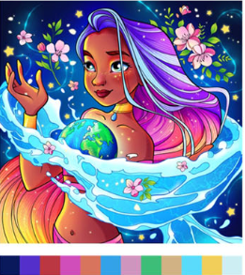
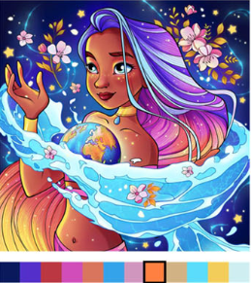
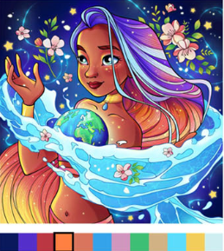
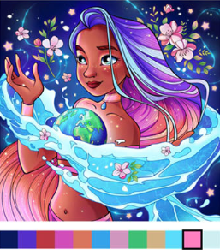
Results
Original
Result 1
Result 2
Result 3
Various generated palettes trained in LAB color space and RGB color space Some visible colors in the source images are highlighted by a LAB-trained model

Slide 8
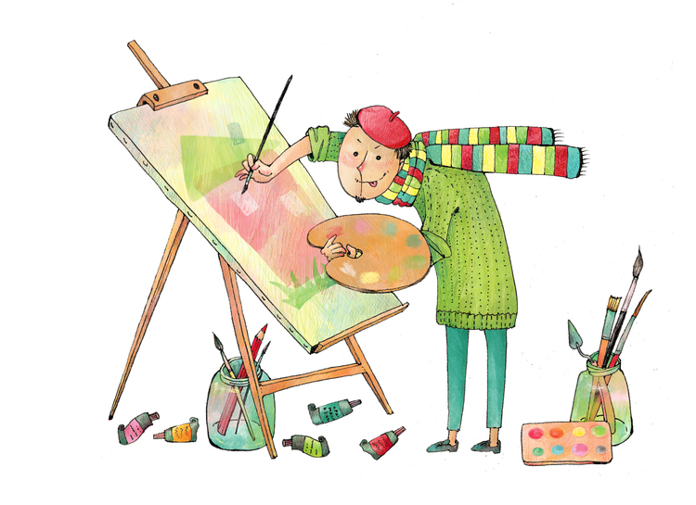
Discussion
Training networks to extract palettes and decompose colors requires a large amount of data and time. Insufficient training can lead to insufficient effectiveness of the method.
The method may have limitations regarding the types of images it can work with effectively. For example, complex compositions or images with a large number of colors can create problems.

Slide 9
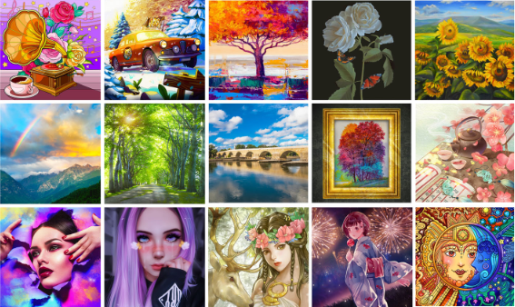
Conclusions
Changing the color palette is used to create new effects, improve visual perception, or adapt images to certain styles and moods.The proposed method effectively changes the color of images, providing high speed and high-quality visual result.

Slide 10

Thank you for your attention

